Slide 1
Recipe Recommender Assignment ML

Slide 2
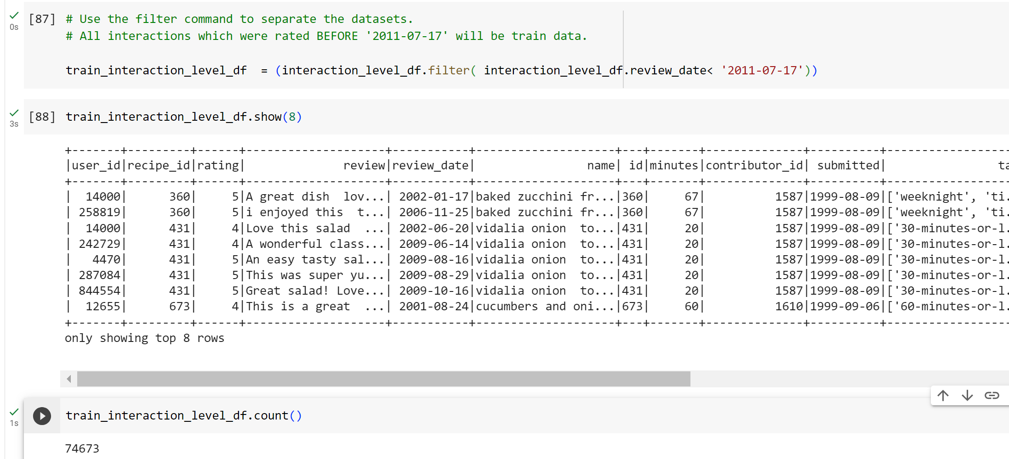
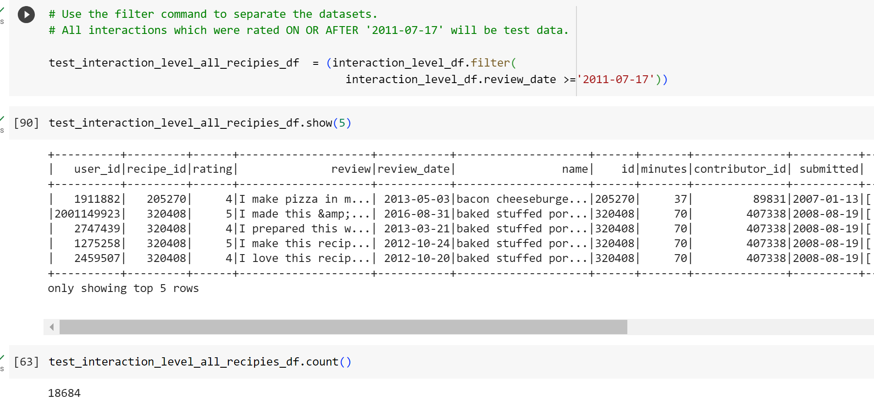
Task 01: Train Test Split : Split the data into two parts before and after 2011-07-17. All reviews in the ratings data after 2011-07-17 will not exist in the training set. For all future predictions the date will be set at 2011-07-18

Slide 3
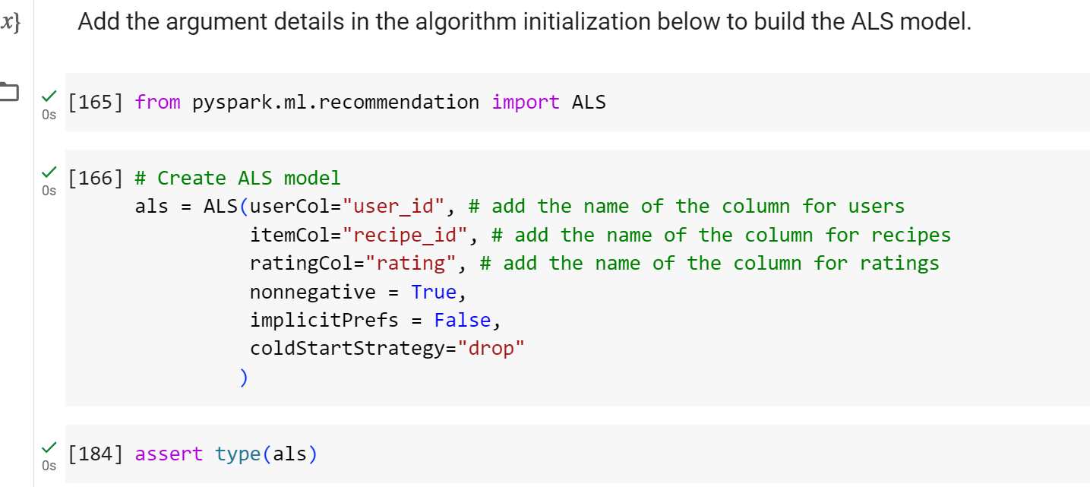
Task 02: Collaborative Filtering Model 1. Build an ALS-based recommender using the native Spark library.

Slide 4
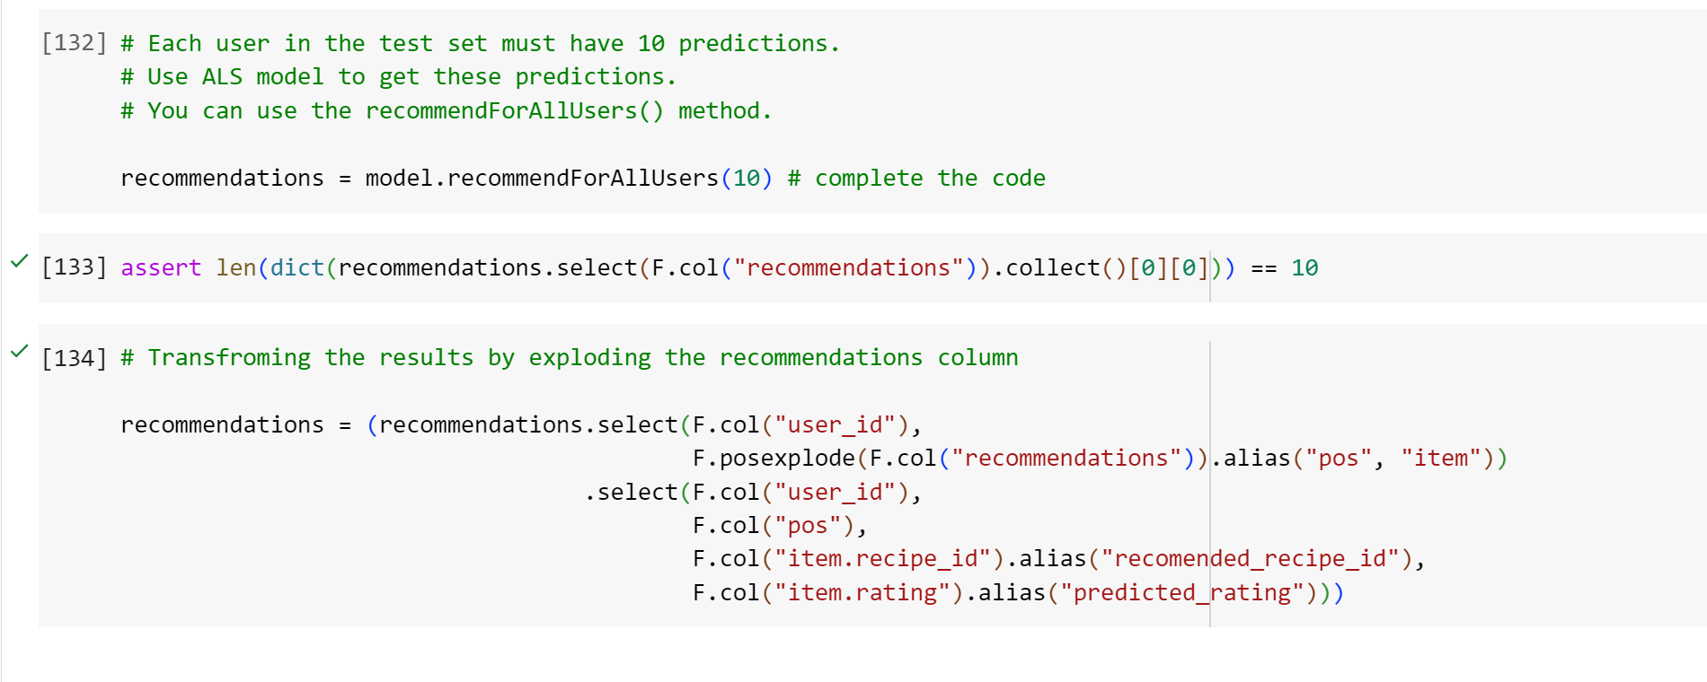
2. Create 10 recommendations for each user in the test data

Slide 5
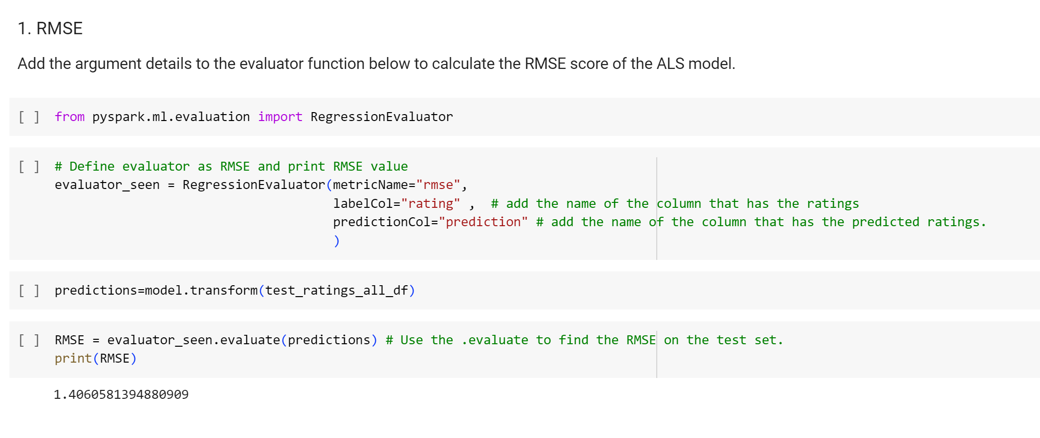
Task 04: Model Evaluation: Evaluate the fit of the ALS model using RMSE.

Slide 6
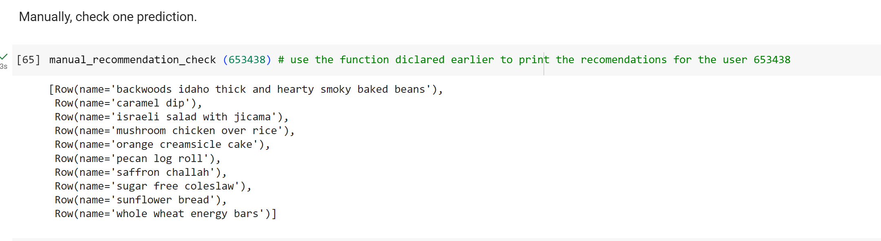
Task 03: KNN models (optional) Task 05: Ensembling Models (optional) -- Manual Prediction Checking

Slide 7
